Slide 1
HUGELKULTUR
(Mound Culture)

Slide 2
What is Hugelkultur
A German word that translates to “hill” or “mound” culture
A traditional farming practice in Eastern Europe and Germany for hundreds of years.
More recently, Herman Andra wrote a gardening booklet in 1962 promoting this practice, followed by Sepp Holzer from Austria, Geoff Lawton from Australia, and Paul Wheaton from USA, who advocate this method of gardening today.
They argue that the practice of hügelkultur creates a self-sustaining garden ecosystem that results in a healthy growing environment for plants.

Slide 3
What Does a Traditional Hugelkultur Mound Look Like?

Slide 4
Essentially What is a Hugelkultur Mound?
It is a garden bed that is developed by layering various types of vegetation that will compost over time and create a lush planting environment.
Since this originated in Germany and Eastern Europe, that makes sense since hundreds of years ago, those areas were probably heavily forested and had lots of fallen trees, limbs, leaves, and materials on the ground that provided ready materials for a hügelkultur mound.
A big compost heap!!

Slide 5
How to Build a Hugelkultur Mound - Overview
First, locate and prepare a bed location – clear a space on the ground, remove grass if you want, or choose a raised bed to build your mound in. You will need to water as you build so bear that in mind when choosing location.
Second, find and gather the materials to use in layering your bed.
Third, place materials in the bed in a particular sequence and shape.
Fourth, let your mound “cook” for a few months.
Fifth, plant in it!

Slide 6
Creating a Mound on the Ground
Shape is important if you are preparing your mound on the ground.
Dig out a sort trench within which to place your materials.
Once completed, this creates a mound deeper in the center and shallower along the sides.
Deeper rooted plants can be located in the middle and shallower rooted plants along the sides.
Width should be what allows you to easily plant and maintain the middle areas.
The mound will flatten out as it decomposes so make it high – at least 3 feet.

Slide 7
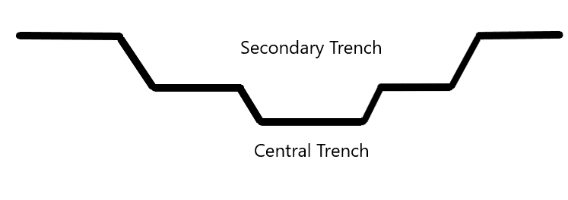

Slide 8
How to Build Your Mound – Materials and Sequence Important
To Start: You can put cardboard or newspaper underneath everything to start if you want. Where are you putting your mound? On the bare ground, in a raised bed?
First Layer: Wood – logs, large diameter branches, large chunks of wood; mix of hardwood and softwood good. Do NOT use black walnut, black locust, treated lumber, eucalyptus, manzanita, red oak, or sycamore.
Second Layer: Smaller branches and leaves. Make this layer as dense as you can, placing branches close together and filling gaps by poking leaves into open areas. WATER WELL after this layer completed.

Slide 9
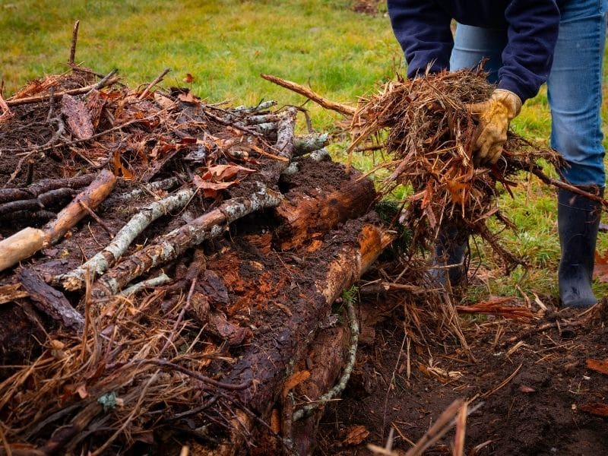
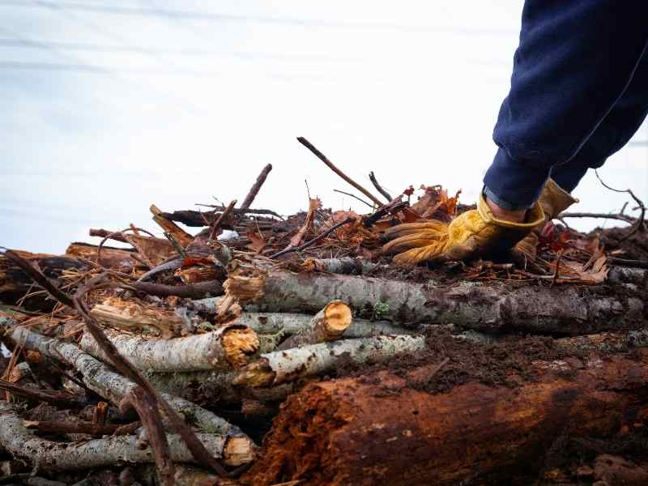

Slide 11
Building Your Mound – continued
Third Layer: Even smaller sticks or branches, wood chips, more leaves, old soil from pots or etc., kitchen scraps. Compress by poking into open areas. Continue to add kitchen scraps as available; do not need to be composted. WATER WELL.
Fourth Layer: Partly rotted compost – from your garden compost heap, horse or cow or lama manure, etc. This should be a thick layer – 3-4 inches. Can continue to add kitchen scraps, more leaves, and wood chips to top off this layer. WATER WELL.

Slide 12
Building Your Mound - continued
Final Layer: For tall raised beds, this is the last 12-15 inches of your bed where you will eventually plant things. For shorter beds or on the ground, this will be about the top 25% of the mound. Fill with a good soil/finished compost mixture to the top of mound or raised bed. WATER WELL.
Mulch - Put a thick layer of mulch on top of your new mound to help with water retention while the mound “cooks.” Can use wood chips, pine needles, leaves, etc.

Slide 13
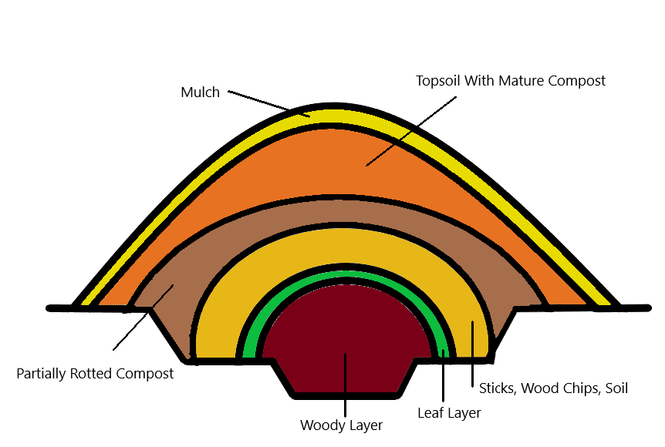

Slide 14
When to Plant and How to Maintain
Apparently some folks plant immediately in the top layer of the mound; however, the majority of gardeners wait for 3 to 6 months to plant so that the mound can decompose and create really great soil.
The mound will shrink in height as it settles and decomposes. Over time, you will need to add a soil/compost mixture to the top of the bed to compensate for the settling.

Slide 15
Benefits of Hugelkultur
Creates great soil if your natural soil is poor.
Uses free organic materials that are readily available.
Mounds are designed for moisture retention since the dense, woody layers retain moisture and release it as necessary. This may take some time, perhaps as much as 3 years, for the sponge to develop.
Excellent drainage.
Can extend the growing season, especially in raised beds, by keeping soil warmer longer into the fall and earlier in spring.
Decomposing materials in bottom provide steady nutrients to the soil.
The mound bed should last for years.
Reduces the amount of soil needed to fill tall raised garden beds.

Slide 16
My Experience Using Hugelkultur
I filled my new 32” high raised beds this way and started in mid-February.
I filled my raised beds with:
2-3 inches of cardboard in very bottom, mixture of soft and hard wood logs in middle of beds filling almost half of the bed height, smaller fruit wood branches pushed all around side of and on top of logs, LOTS of dry leaves pushed into crevices all way to bottom and thick layer on top of wood. I watered well a few times. The leaves compressed after a day or so and I added more on top, watering each time I added another layer.

Slide 17
My Beds - continued
I added kitchen scraps almost daily on top of and in between the leaves.
Next came a thick layer – probably 3 inches at least – of partially composted horse manure, topped with more leaves and kitchen scraps, watering well.
Then I added 12-15 inches of a soil/mature compost mixture almost to the very top of my beds as the planting medium. I watered well.
I finished with a layer of wood chips as mulch.

Slide 18
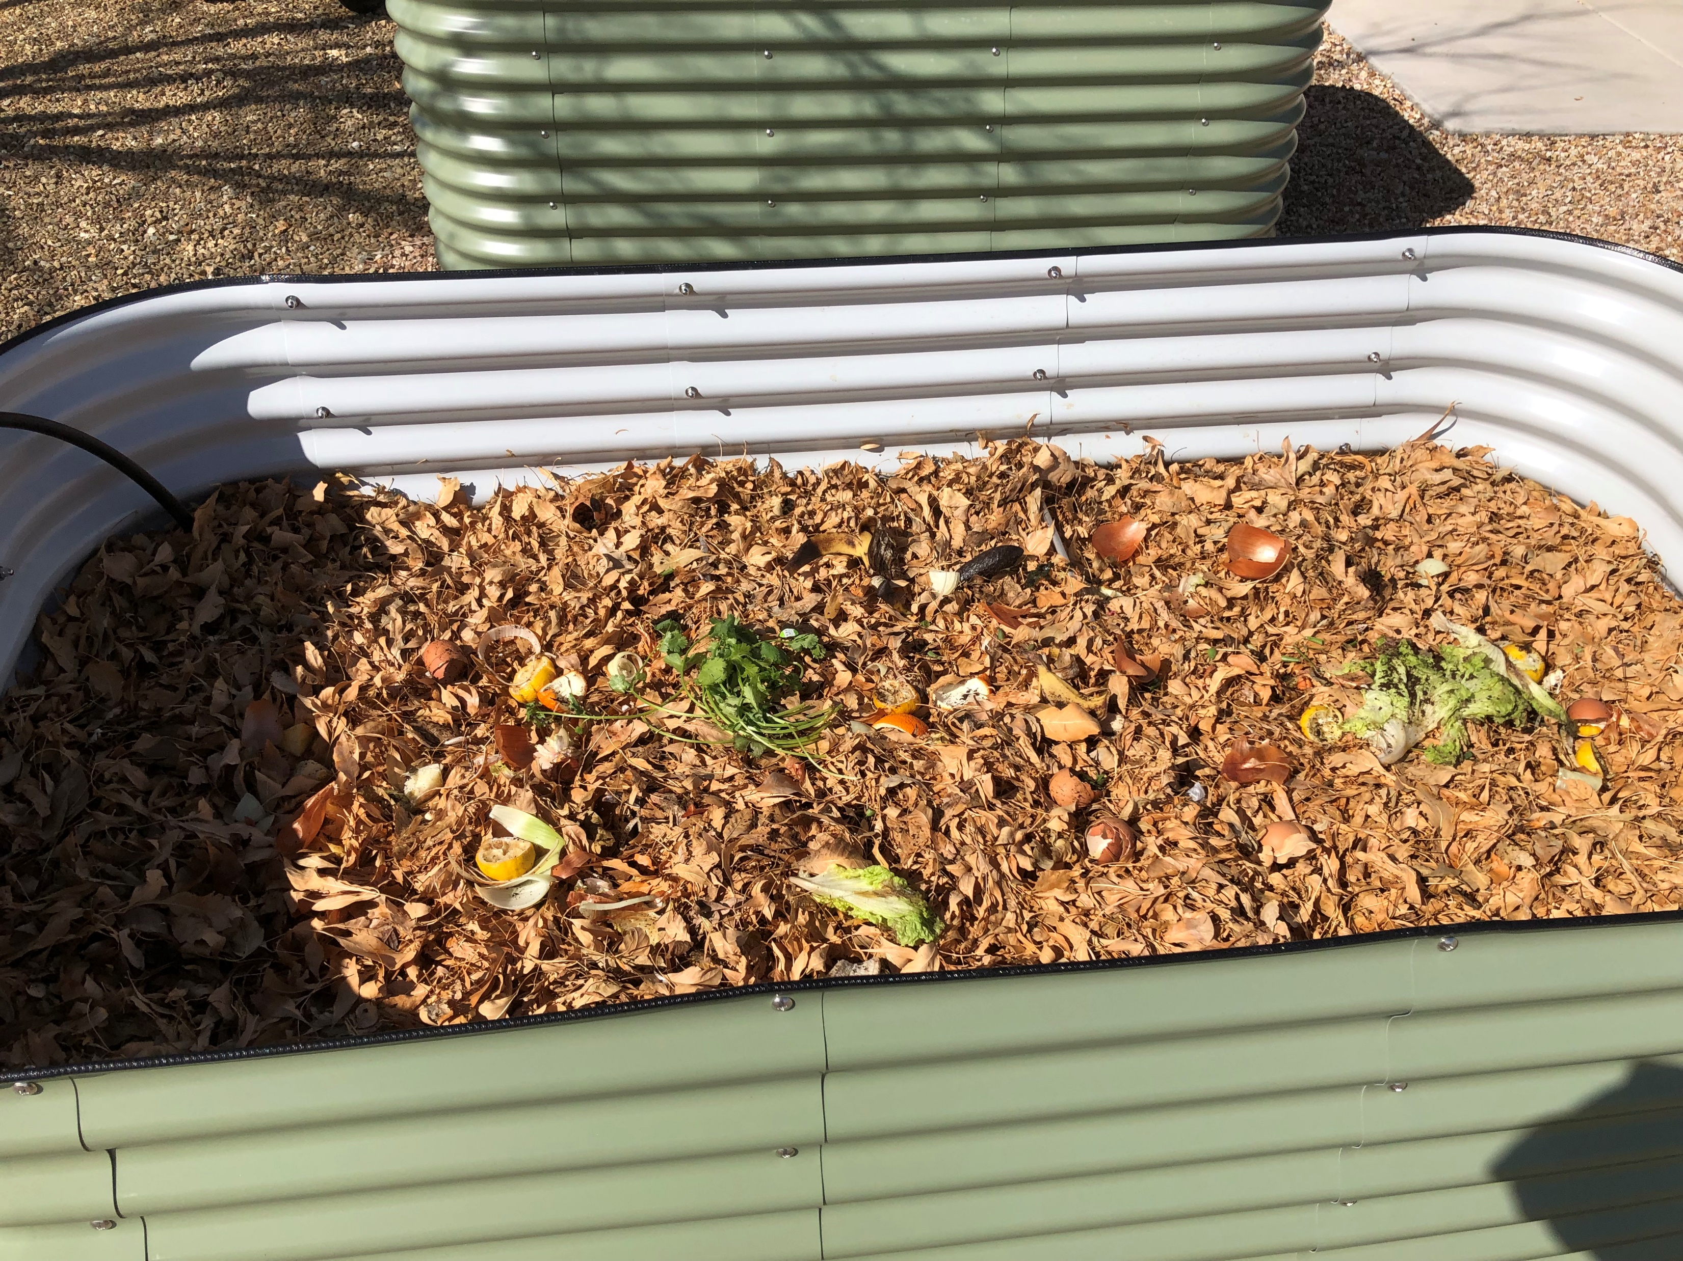

Slide 19
My Results and Take Aways
My raised beds cooked from end of February to mid May. They shrunk a few inches in that time, but I did not add anymore soil.
The deepest holes I dug were for my tomato plants. I thought I would hit wood (!) but there was nothing but really rich-looking soil under the surface. I also put in a couple of long stakes expecting something underneath to stop them, but they went right down deeply into the soil.
Take Away: The beds have continued to shrink down after planting with vegetables and there is some cracking of soil along the middle of two beds which I think is another symptom of the soil settling. If I did this again, I would prepare the mounds in the fall and let them decompose over winter, then add more topsoil and compress the beds before planting.

Slide 20
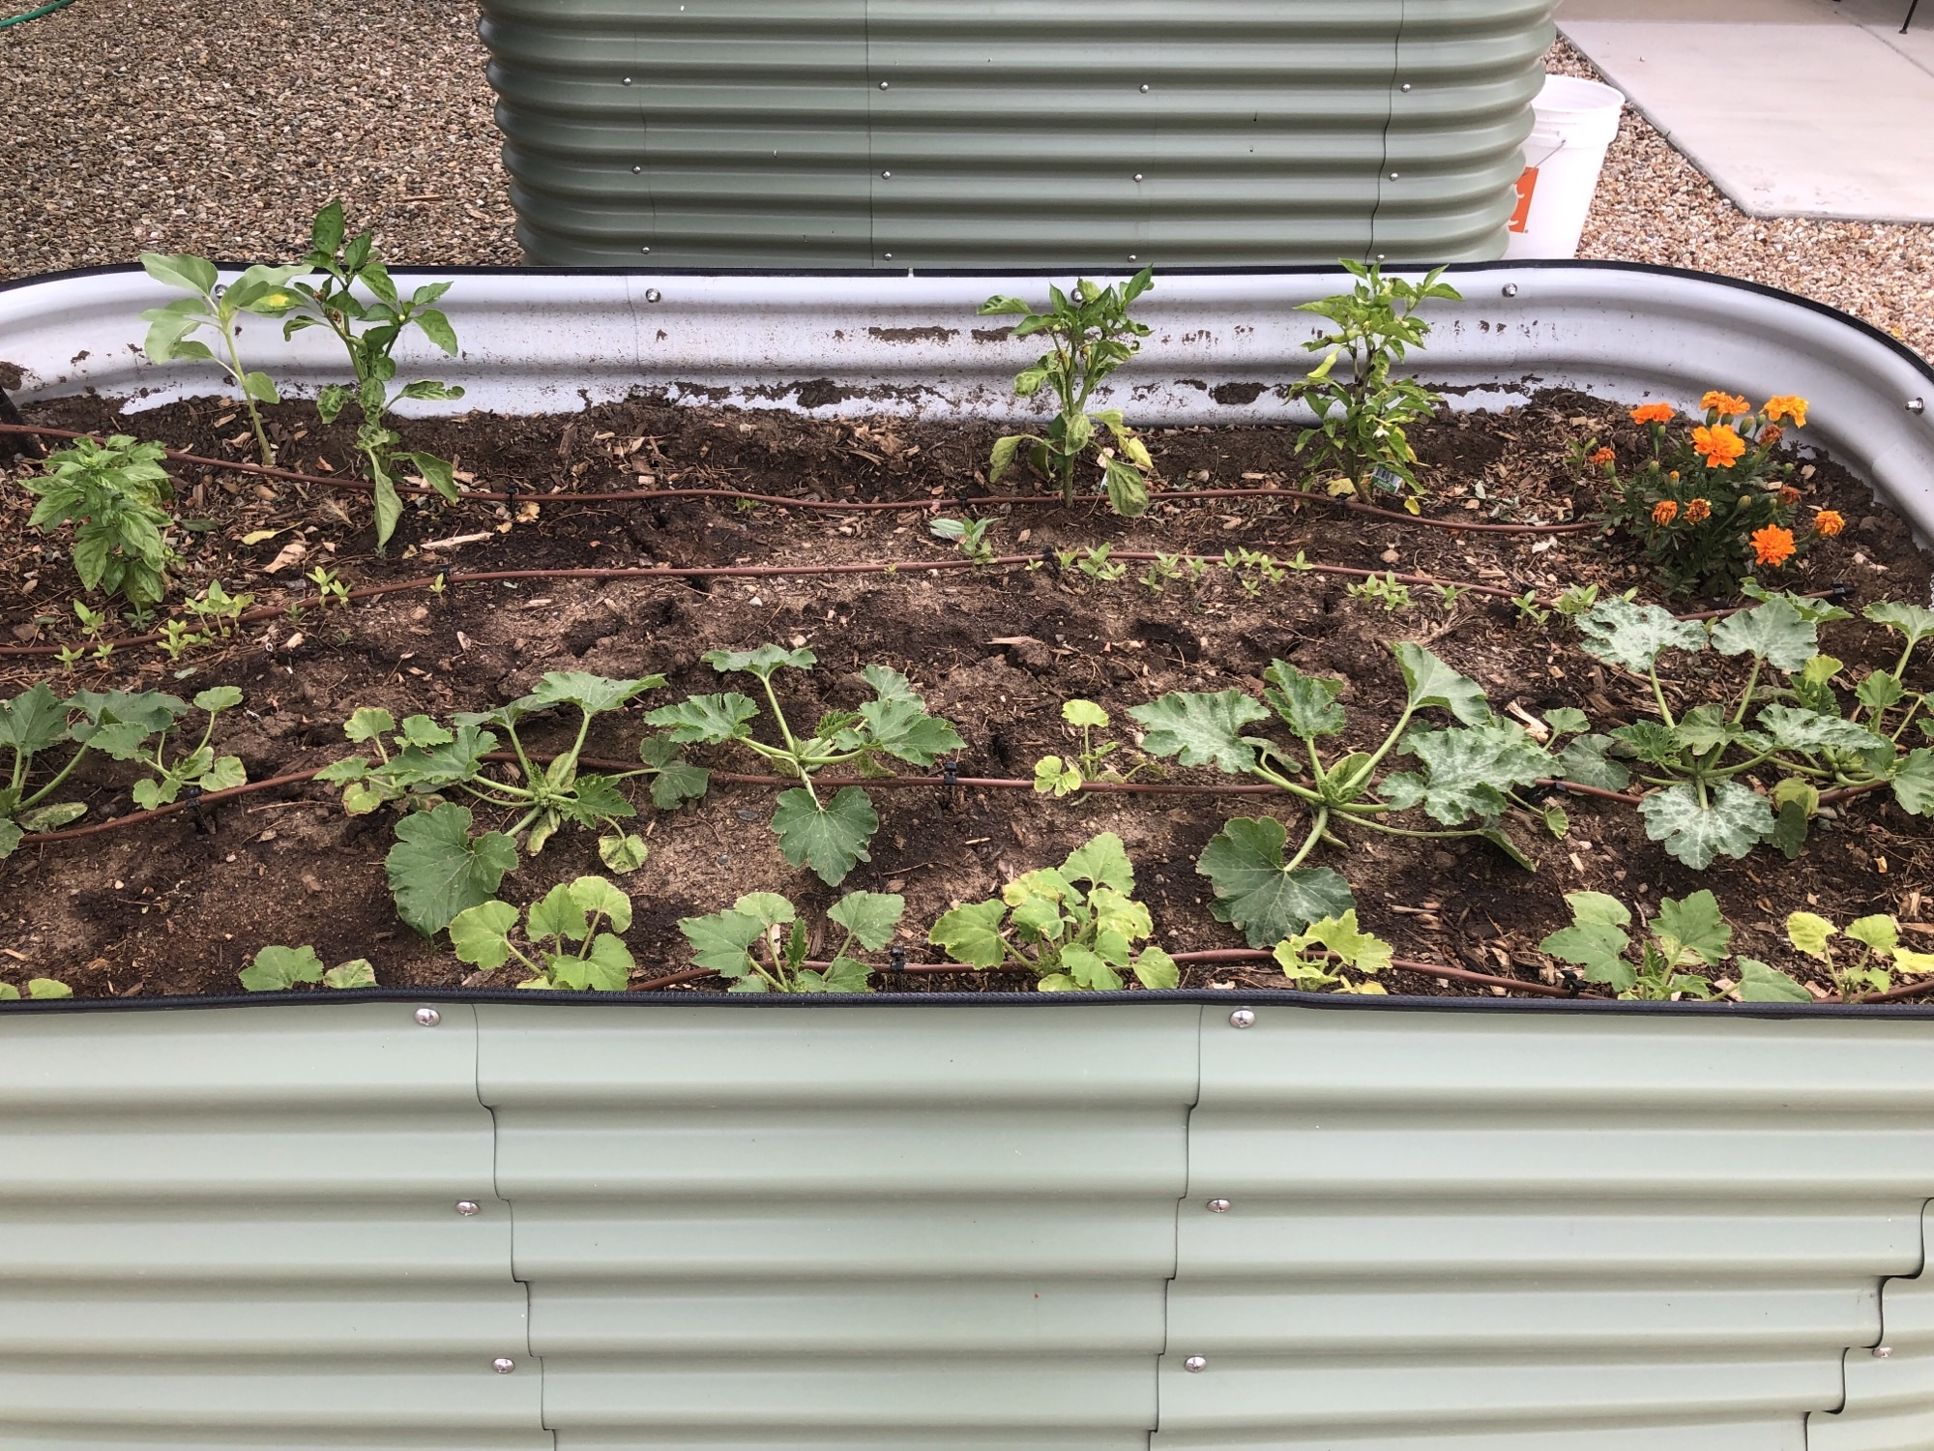

Slide 21
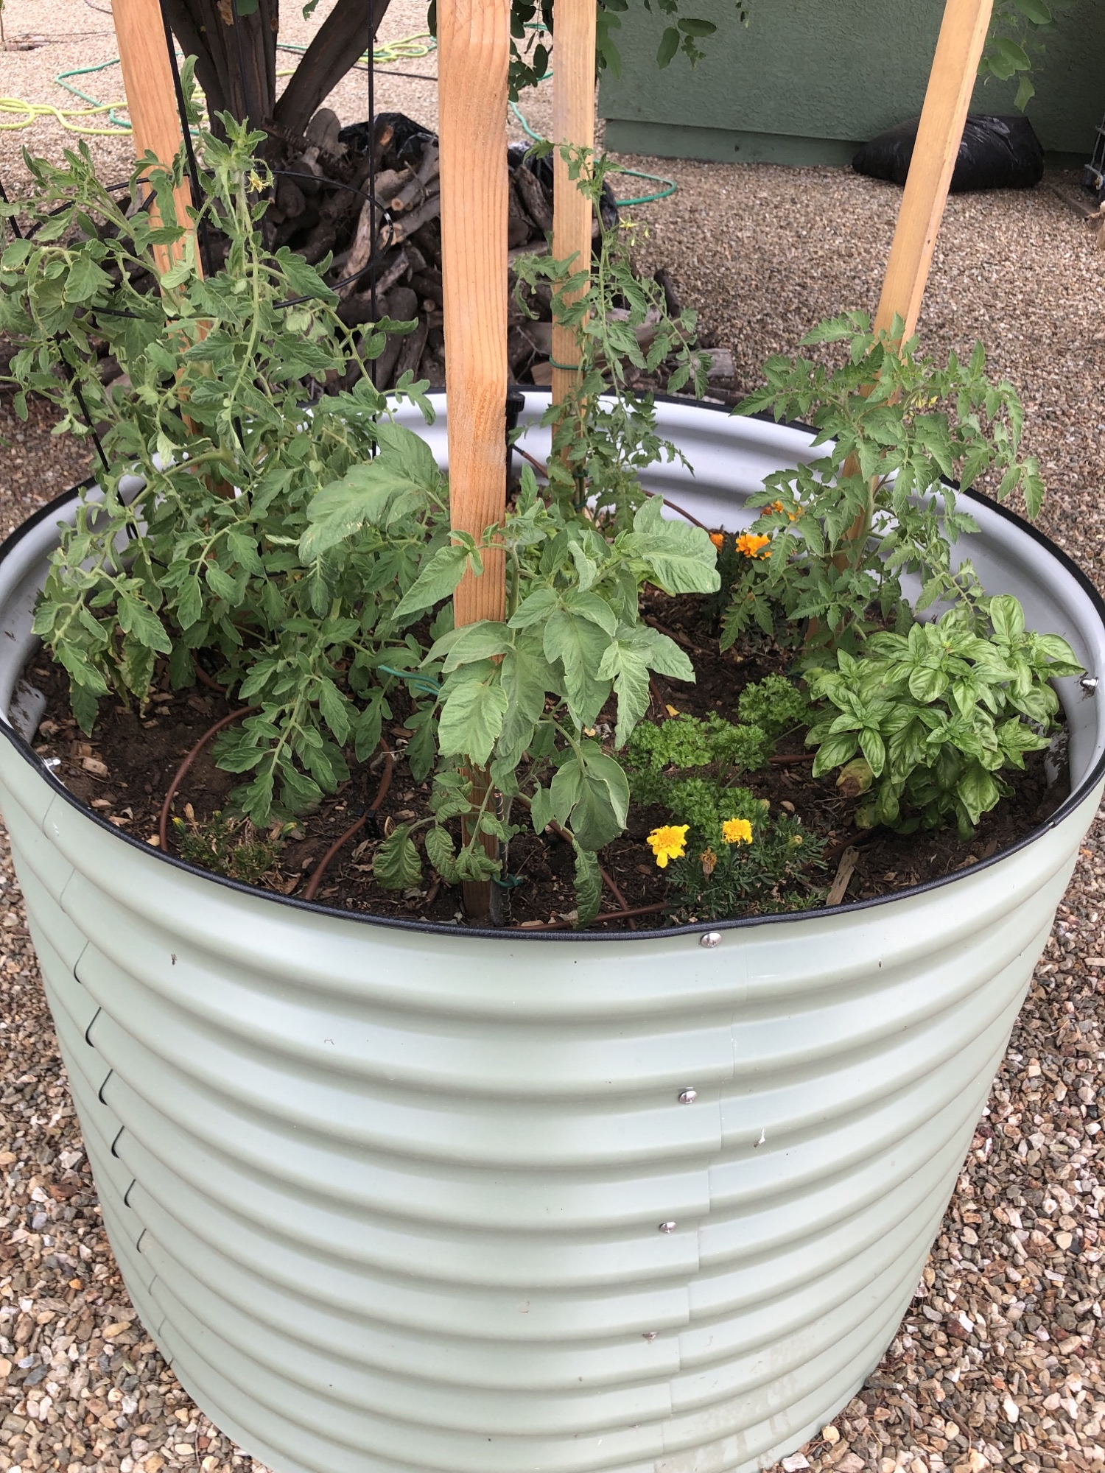

Slide 22
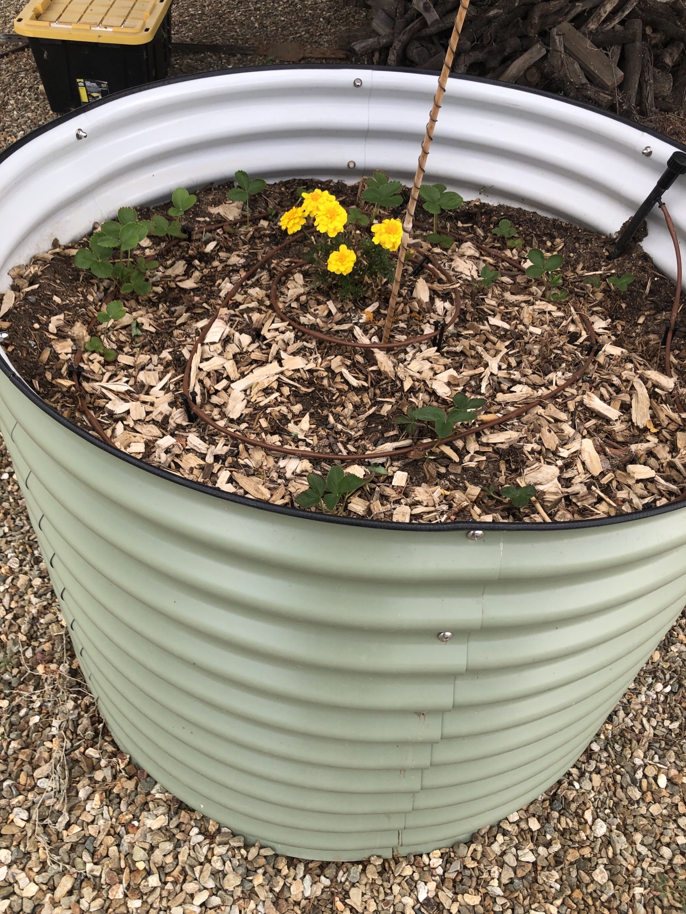

Slide 23
QUESTIONS??

